Slide 1
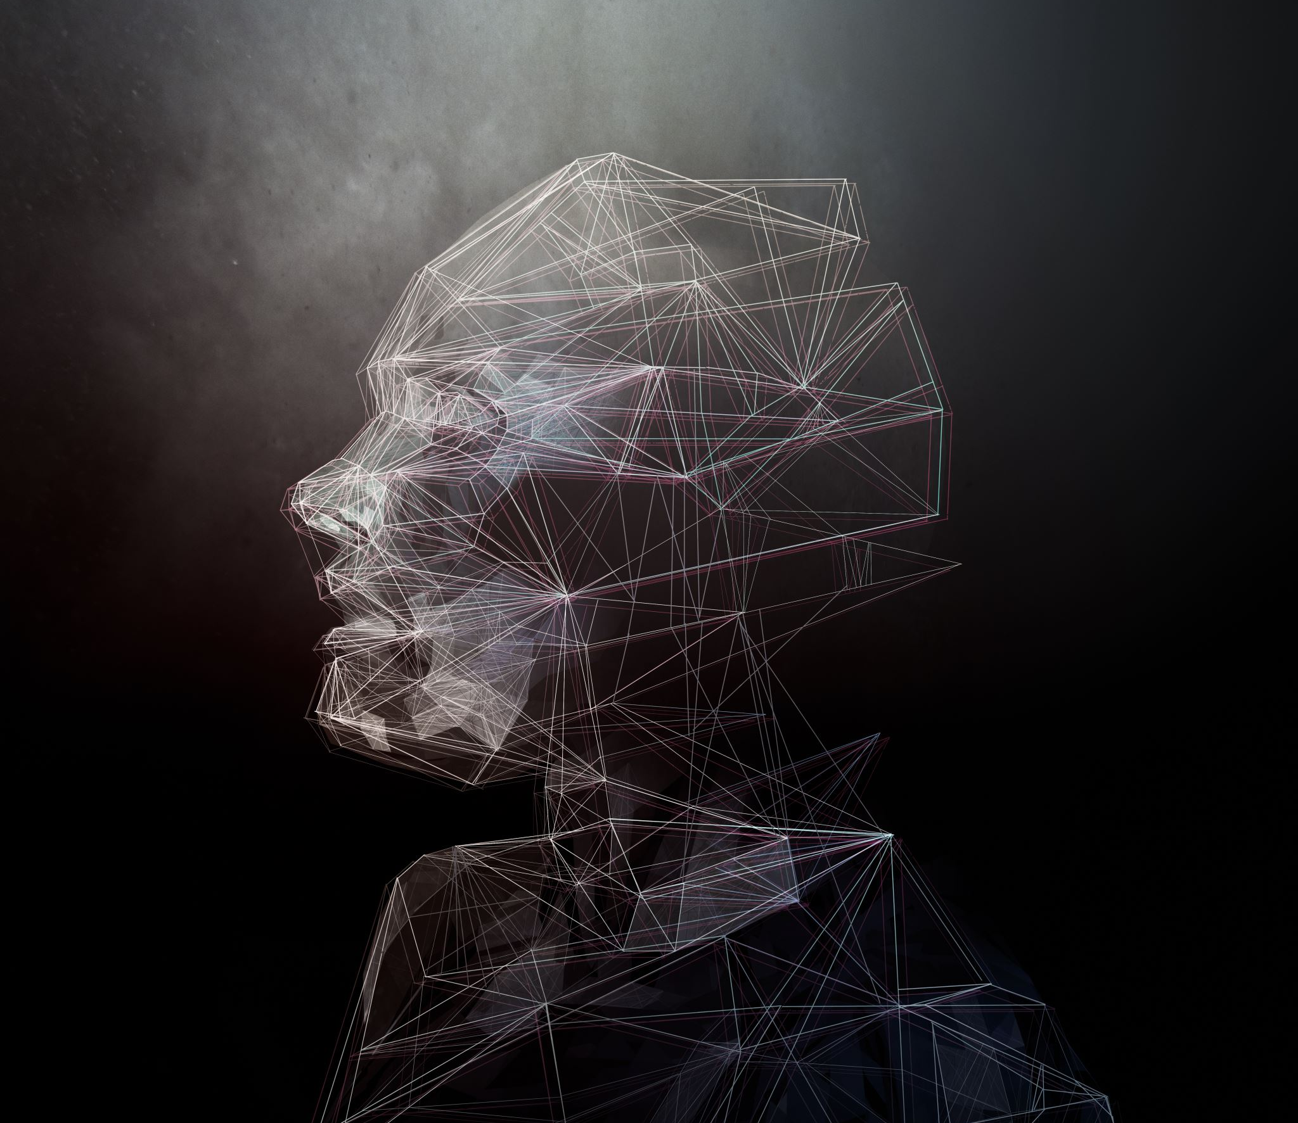
Facial Recognition
Baby sowjanya Damarla –C00314717 Ayomide Otinwa-C00313536

Slide 2

EXECUTIVE SUMMARY
Content:
Brief overview of the project objectives and outcomes:
Developed a facial recognition system using Raspberry Pi.
Real-time recognition with a user-friendly interface.
Addressed challenges in deploying AI on low-powered devices.
Techniques Used: AI models, edge computing.
Applications: Personalized security, attendance systems.

Slide 3
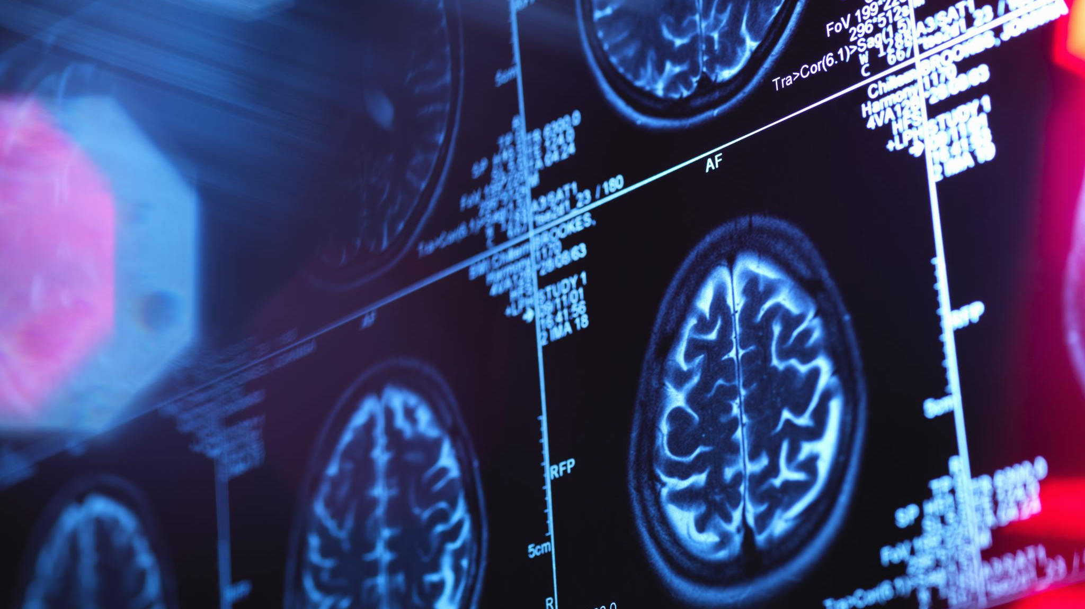
INTRODUCTION
Background:
History of facial recognition:
From PCA (1990) to modern deep learning models like FaceNet and DeepFace.
Growth in practical applications: security, automation, personalization.
Problem Statement:
Challenge of implementing real-time facial recognition on low-power devices like Raspberry Pi.
Objectives:
Develop a cost-effective system with real-time capabilities.
Address compatibility and environmental challenges.

Slide 4
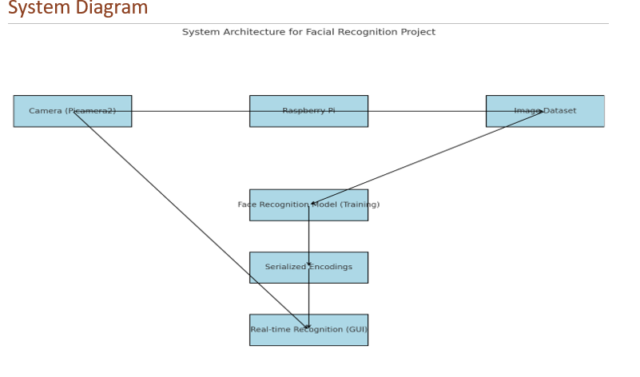
SYSTEM ARCHITECTURE
SYSTEM ARCHITECTURE
Key Components
Raspberry Pi 4 Model B: Processes data locally.
Camera (Raspberry Pi Noir V2): Captures input images.
AI Libraries: face_recognition and OpenCV.
GUI: Tkinter for user interaction.
Workflow
Steps: Capture ➝ Process ➝ Recognize ➝ Display.

Slide 5
AI and Edge Computing Techniques
AI Models
Algorithm: Histogram of Oriented Gradients (HOG) for face detection.
Embedding: Pre-trained DNN generates facial encodings.
Edge Benefits
Latency: Faster recognition by processing on-device.
Privacy: No data sent to external servers.
Optimization Strategies
Downscaling images to 320x240 for faster processing.
Using lightweight libraries like OpenCV Headless.

Slide 6
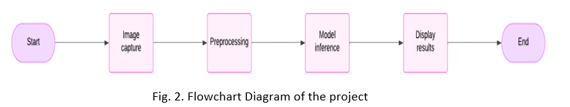
Implementation
Development Phases
Planning and Research: Selecting tools and hardware.
Data Collection: Creating single-user datasets.
Model Training: Generating facial encodings.
Integration: Combining recognition with Tkinter GUI.
Optimization: Reducing lag and improving usability.
Tools
Python, OpenCV, face_recognition, Picamera2.

Slide 7
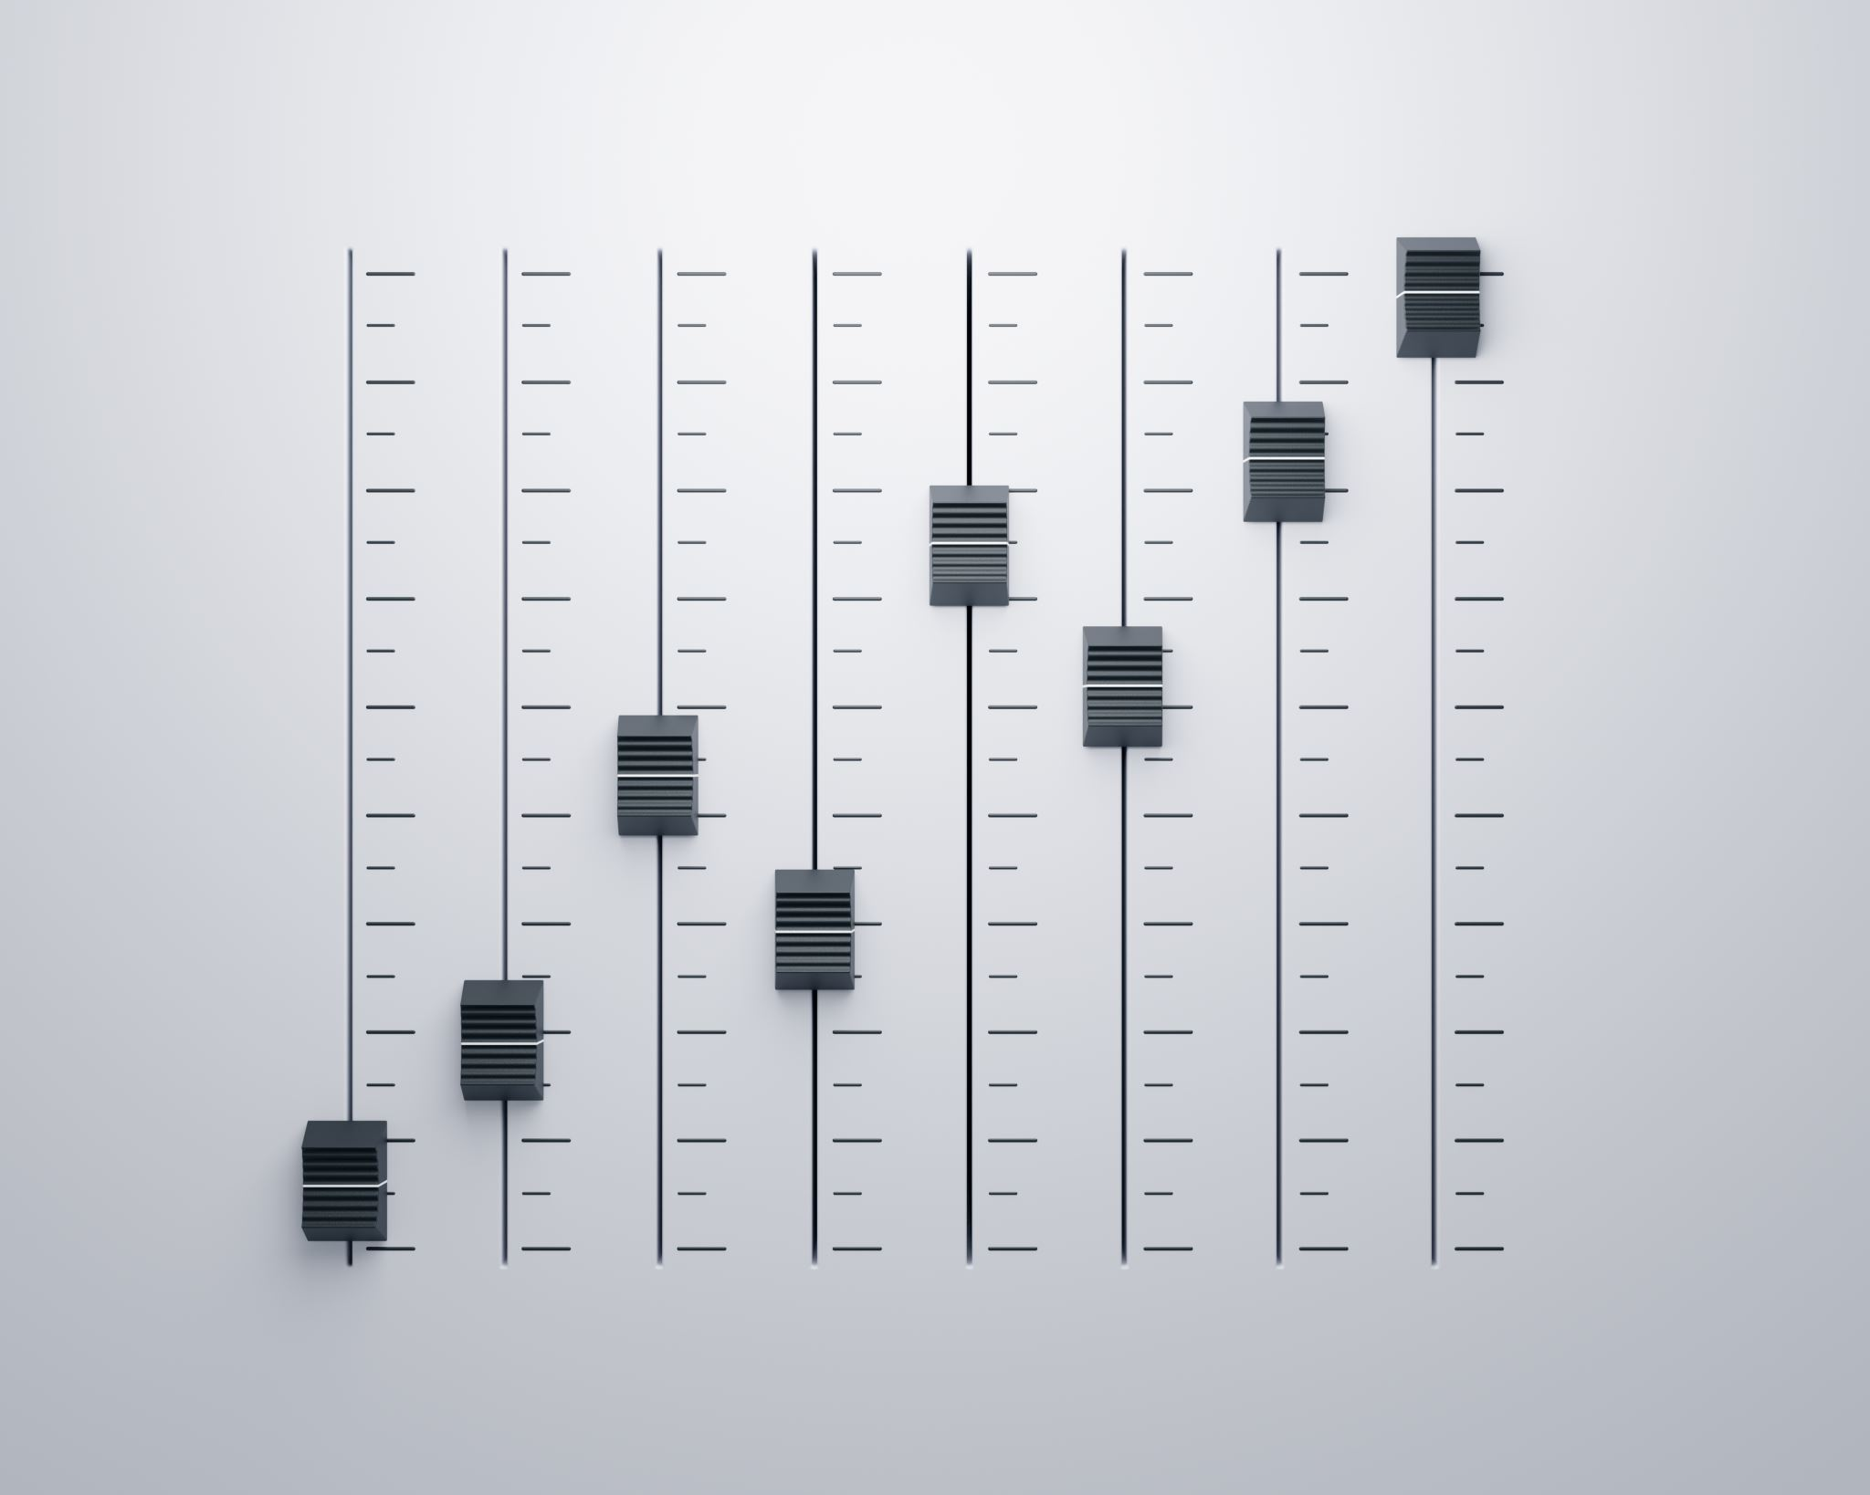
User Interaction and UI/UX
Interface Features:
Live camera feed.
Real-time feedback: "Welcome, [Name]" or "Unknown.“
Accessibility
Large fonts, high-contrast colors, minimalistic layout.

Slide 8

Challenges and Solutions
Key Challenges
Compatibility issues between libraries.
Managing Python environments and dependencies.
Solutions
Manual installation of compatible packages.
Carefully tracking changes to system configurations.
Lessons Learned
Importance of dependency management and environment isolation.
Consideration of tools like Docker for future projects.

Slide 9

Ethical and Legal Considerations
Ethical Issues
Bias in AI models: Gender and demographic disparities.
Privacy concerns in facial recognition.
Legal Compliance
GDPR alignment: Local data processing, no storage of PII.
Future Enhancements
Data anonymization and encryption.

Slide 10

Results
Achievements:
Successfully recognized faces in real-time.
Created a lightweight, deployable system on Raspberry Pi.
Limitations
Focused on single-user datasets.
No integration of advanced deep learning models.

Slide 11
Future Work
Enhancements
Implementing advanced AI models like TensorFlow Lite.
Expanding to multi-user datasets.
Adding voice or fingerprint integration for multi-modal recognition.
Applications
Smart home systems, attendance tracking, personalized security.

Slide 12
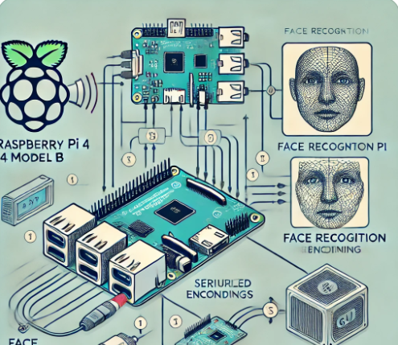
CONCLUSION
Achieved real-time, on-device recognition using affordable hardware.
Learned critical lessons in system optimization and user design.
Demonstrated feasibility of deploying AI at the edge for practical applications.

Slide 13
REFERENCES
Joy Buolamwini and Timnit Gebru, "Gender Shades: Intersectional accuracy disparities in commercial gender classification," Proceedings of the ACM FAT, 2018.
2. Michael Kirby and Lawrence Sirovich, "Application of the Karhunen-Loeve procedure for the characterization of human faces," IEEE Transactions on Pattern Analysis and Machine Intelligence, vol. 12, no. 1, pp. 103–108, 1990.
3. Florian Schroff, Dmitry Kalenichenko, and James Philbin, "FaceNet: A unified embedding for face recognition and clustering," Proceedings of the IEEE CVPR, 2015.
4. Yaniv Taigman, Ming Yang, Marc'Aurelio Ranzato, and Lior Wolf, "DeepFace: Closing the gap to human-level performance in face verification," Proceedings of the IEEE CVPR, 2014.
5. Matthew Turk and Alex Pentland, "Eigenfaces for recognition," Journal of Cognitive Neuroscience, vol. 3, no. 1, pp. 71–86, 1991

